Slide 1
Unit 3
Combinational Logic Circuits

Slide 2
Quine-McCluskey minimization technique
Introduction to Combinational Circuits
Carry look ahead adder
Decimal adder
Multiplexer
Demultiplexer
Magnitude Comparator
Problem solving session
Decoder
Encoder
Read –only Memory
Arithmetic Logic Unit
Programmable Logic Arrays
HDL Gate and Data Flow modeling
HDL Behavioral modeling
Binary adder
Binary adder as subtractor

Slide 3
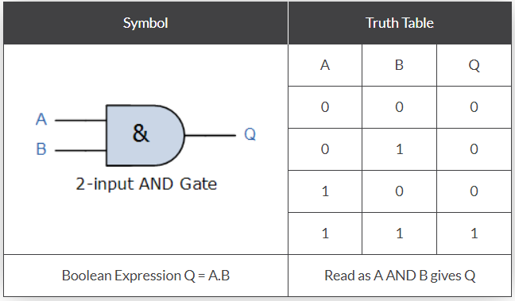
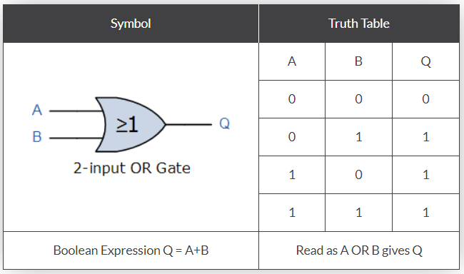
Basic Logic Gates
The Logic OR Gate
The Logic AND Gate

Slide 4
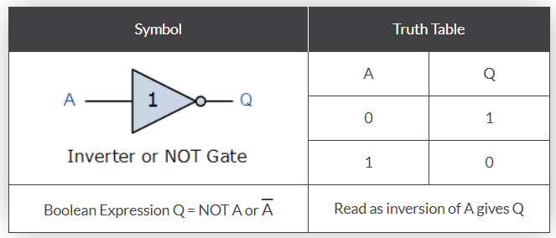
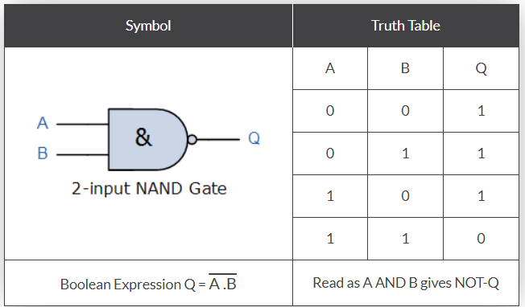
The Logic NOT Gate
The Logic NAND Gate

Slide 5
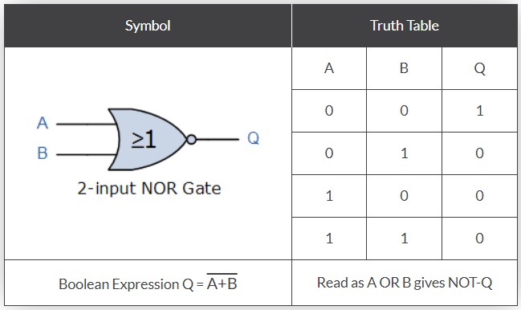
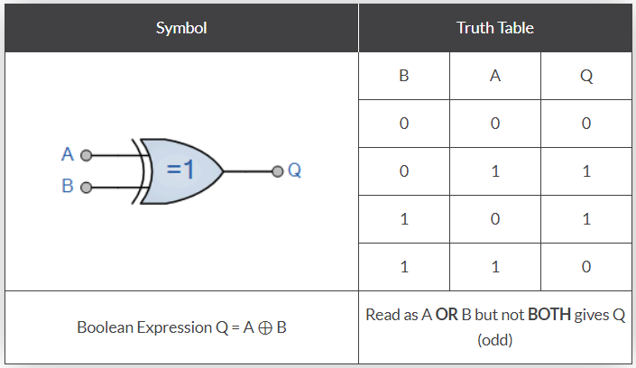
The Logic NOR Gate
The Logic EXOR Gate
Notes:
EX OR ab”+a’b

Slide 6
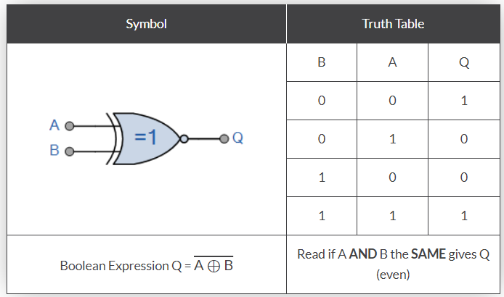
The Logic XNOR Gate

Slide 7
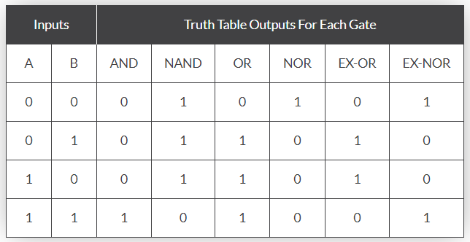
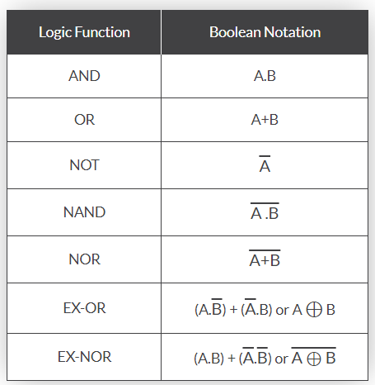
Consolidation of Logic Gates

Slide 8
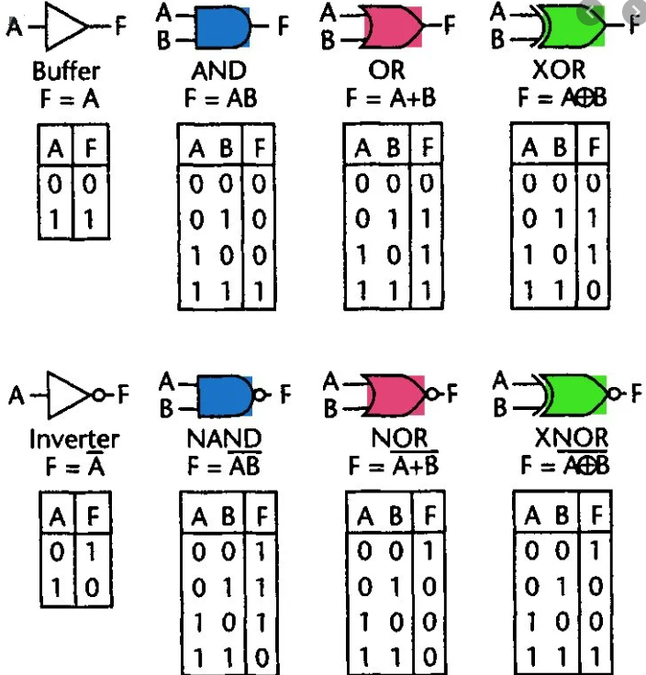

Slide 9
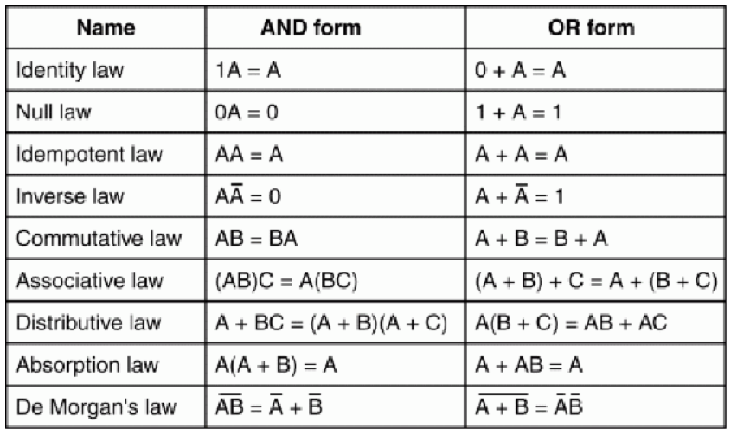
Boolean Rules and Laws
Notes:
A=1 b= 0 c=1 bc =0 a(bc)=0
Ab=0 (ab)c=0

Slide 10
Sum of Product (SOP) and Product of Sum (POS)

Slide 11
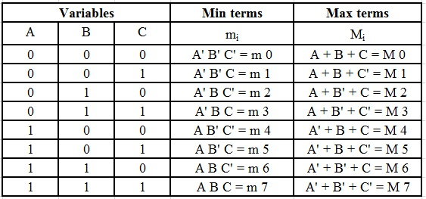
Minterm and Maxterm
A minterm is defined as the product term of n variables, in which each of the n variables will appear once either in its complemented or un-complemented form.
A maxterm is defined as the sum term of n variables, in which each of the n variables will appear once either in its complemented or un-complemented form.
Notes:
Abcd 1100 abc’d’ a’+b’+c+d ----m12

Slide 12
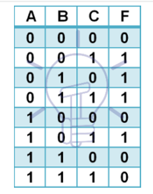


Sum of Product (SOP) Form
The Sum of Product form is a form of expression in Boolean algebra in which different product terms of inputs are being summed together.
Example:
Canonical or Standard SOP form

Slide 13


Product of Sum (POS) Form
The Product of Sum form is a form in which products of different sum terms of inputs are taken.
Example:
Canonical or Standard POS form

Slide 14
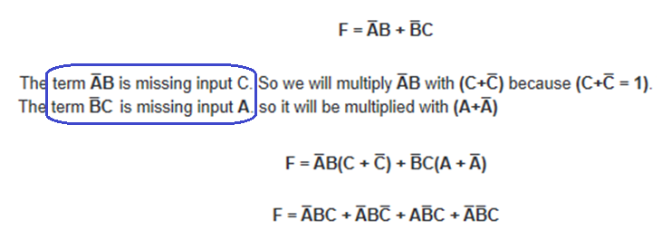
Conversion from Minimal SOP to Canonical SOP Form
Example:
Missing input variables need to be multiplied

Slide 15

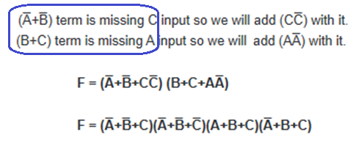
Conversion from Minimal POS to Canonical POS Form
Example:
Missing input variables need to be added

Slide 16
Conversion of SOP to POS
To convert the SOP form into POS form, first we should change the Σ to Π and then write the numeric indexes of missing variables of the given Boolean function.
Example:
F = ∑ _{A, B, C} (0, 2, 3, 5, 7) = A’ B’ C’ + A B’ C’ + A B’ C + ABC’ + ABC
Note: writing the missing indexes of the terms i.e., 1 - 001, 4 - 100 and 6 - 110.
001 = (A + B + C’), 100 = (A’ + B + C), 110 = (A’ + B’ + C)
Hence,
F = Π _{A, B, C} (1, 4, 6) = (A + B + C’) * (A’ + B + C) * (A’ + B’ + C)

Slide 17
Conversion of POS to SOP
To convert the POS form into SOP form, first we should change the Π to Σ and then write the numeric indexes of missing variables of the given Boolean function.
Example:
F = Π _{A, B, C} (2, 3, 5) = (A+B’+C) * (A+B’+C’) * (A’+B+C’)
Note: writing the missing indexes of the terms, 0 - 000, 1 - 001, 4 - 100, 6 - 110, and 7 - 111.
000 = A’ * B’ * C’, 001 = A’ * B’ * C, 100 = A * B’ * C’, 110 = A * B* C’, 111 = A * B * C
Hence,
F = Σ _{A, B, C} (0, 1, 4, 6, 7) = (A’ * B’ * C’) + (A’ * B’ * C) + (A * B’ * C’) + (A * B* C’) + (A * B * C)

Slide 18
Karnaugh Map (K-Map)

Slide 19
K-map
K-Map is used to minimize the number of logic gates by minimizing the logical expression.
The minimization will reduce cost, complexity and power consumption.
An n-variable K-map has 2 ^{n} cells with each cell corresponding to an n-variable truth table value.
If 2 variable – 4 cells
If 3 variable – 8 cells
If 4 variable – 16 cells
K-map cells are arranged such that adjacent cells correspond to truth rows that differ in only one bit position.

Slide 20
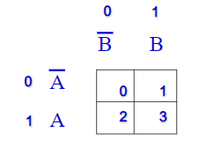
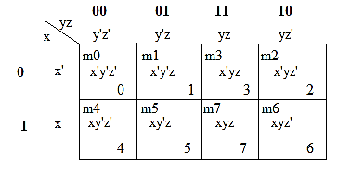
2 variables K-Map
3 variables K-Map

Slide 21
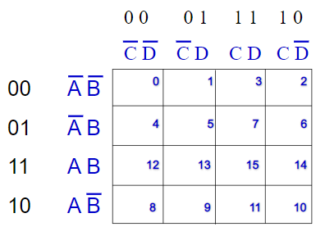
4 variables K-Map

Slide 22
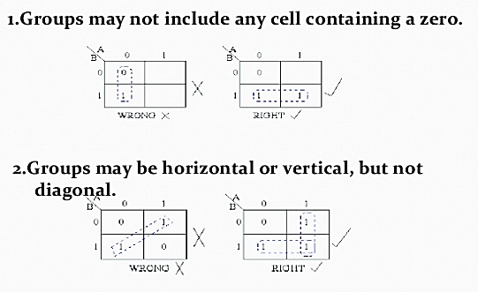
K-map Rules

Slide 23

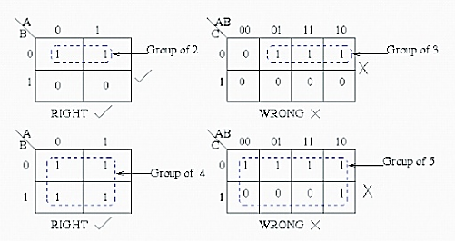
K-map Rules

Slide 24
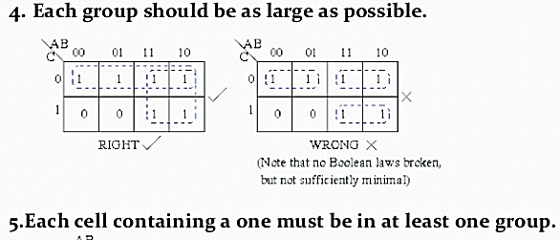
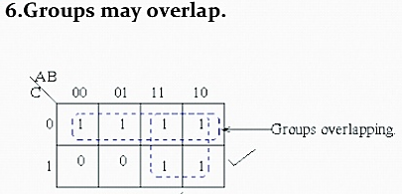
K-map Rules

Slide 25
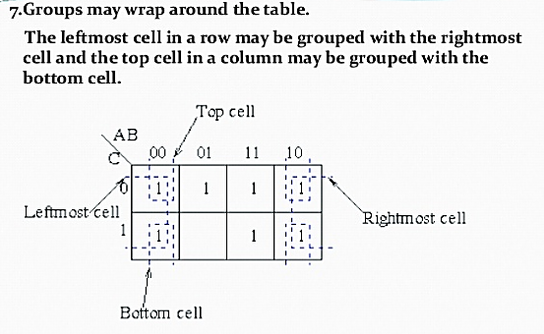
K-map Rules

Slide 26
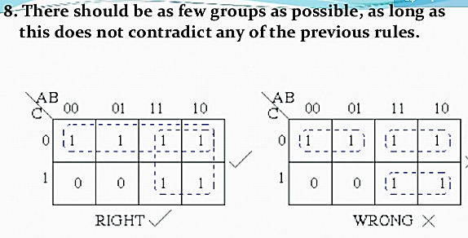
K-map Rules

Slide 27
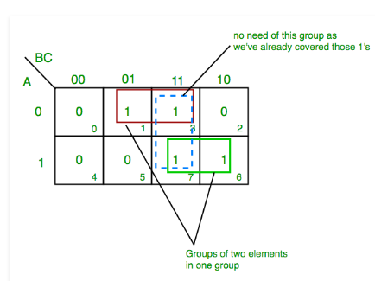
Example 1
For the given minterms, find the reduced logical expression using K-Map Z= ∑_{A,B,C}(1,3,6,7)
From green group we get product term—
AB
From red group we get product term—
A’C
Z= A’C+AB

Slide 28
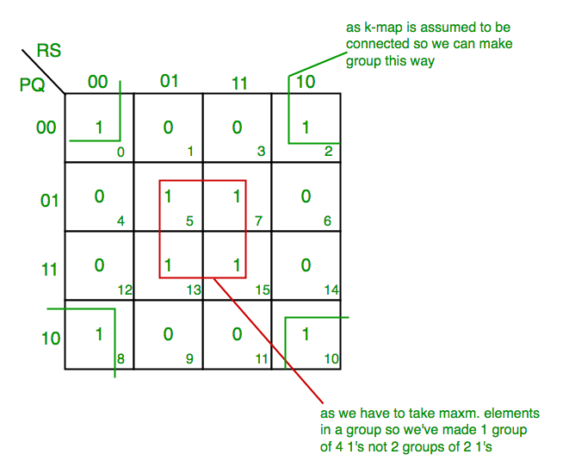
Example 2
For the given minterms, find the reduced logical expression using K-Map F(P,Q,R,S)=∑(0,2,5,7,8,10,13,15)
From green group we get product term—
Q’S’
From red group we get product term—
QS
F = QS+Q’S’

Slide 29
K-map with Don’t cares
A “don’t care” condition is a combination of inputs for which the output may either ‘1’ or ‘0’.
Hence “don’t care” conditions may either be included or excluded while grouping is made.
It is usually denoted as ‘X’ in the K-Map table.

Slide 30
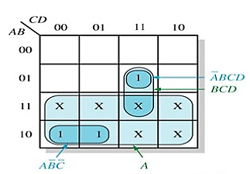
Example 3
For the given minterms, find the reduced logical expression using K-Map
Z= ∑_{A,B,C}(7, 8, 9) + ∑_{d}(10, 11, 12, 13, 14, 15)
Z = AB’C’+A’BCD (without don’t cares)
Z = A+BCD (with don’t cares)

Slide 31
Quine-McCluskey Method (Tabulation Method)

Slide 32
A systematic simplification procedure to reduce a minterm expansion to a minimum sum of products.
Use XY + XY’ = X to eliminate as many as literals as possible.
The resulting terms = prime implicants.
Use a prime implicant chart to select a minimum set of prime implicants.

Slide 33
Determination of Prime Implicants
Eliminate literals
Two terms can be combined if they differ in exactly one variable.
AB’CD’ + AB’CD = AB’C
1 0 1 0 + 1 0 1 1 = 1 0 1
X Y X Y’ X
A’BC’D + A’BCD’ (won’t combine)
0 1 0 1 + 0 1 1 0 (check # of 1’s)
We need to compare and combine whenever possible.

Slide 34
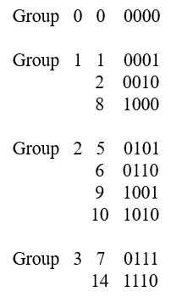
Sorting to Reduce Comparisons
Sort into groups according to the number of 1’s.
F(a,b,c.d) = Σm(0,1,2,5,6,7,8,9,10,14)
No need for comparisons
(1) Terms in nonadjacent group
(2) Terms in the same group

Slide 35
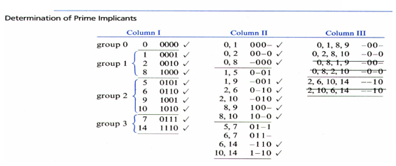
Comparison of adjacent groups
Use X + X = X repeatedly between adjacent groups
Those combined are checked off.
Combine terms that have the same dashes and differ one in the number of 1’s. (for column II and column III)

Slide 36
Prime Implicants
The terms that have not been checked off are called prime implicants.
f = 0-01 + 01-1+011- + -00-
+ -0-0 + --10
= a’c’d + a’bd + a’bc + b’c’ +
b’d’ + cd’
Each term has a minimum number of literals, but minimum SOP for f:
f = a’bd + b’c’ + cd’
(a’bd, cd’ => a’bc)
(a’bd, b’c’ => a’c’d)
(b’c’, cd’ => b’d’)

Slide 37
Definition of Implicant
Definition
Given a function of F of n variables, a product term P is an implicant of F iff for every combination of values of the n variables for which P = 1, F is also equal to 1.
Every minterm of F is an implicant of F.
Any term formed by combining two or more minterms is an implicant.
If F is written in SOP form, every product term is an implicant.
Example: f(a,b,c) = a’b’c’ + ab’c’ + ab’c + abc = b’c’ + ac
If a’b’c’ = 1, then F = 1, if ac = 1, then F = 1. a’b’c’ and ac are implicants.
If bc = 1, (but a = 0), F = 0, so bc is not an implicant of F.

Slide 38
Definition of Prime Implicant
Definition
A prime implicant of a function F is a product term implicant which is no longer an implicant if any literal is deleted from it.
Example: f(a,b,c) = a’b’c’ + ab’c’ + ab’c + abc = b’c’ + ac
Implicant a’b’c’ is not a prime implicant. Why? If a’ is deleted, b’c’ is still an implicant of F.
b’c’ and ac are prime implicants.
Each prime implicant of a function has a minimum number of literals that no more literals can be eliminated from it or by combining it with other terms.

Slide 39
Quine McClusky Procedure
QM procedure:
Find all product term implicants of a function
Combine non-prime implicants.
Remaining terms are prime implicants.
A minimum SOP expression consists of a sum of some (not necessarily all) of the prime implicants of that function.
We need to select a minimum set of prime implicants.
If an SOP expression contains a term which is not a prime implicant, the SOP cannot be minimum

Slide 40
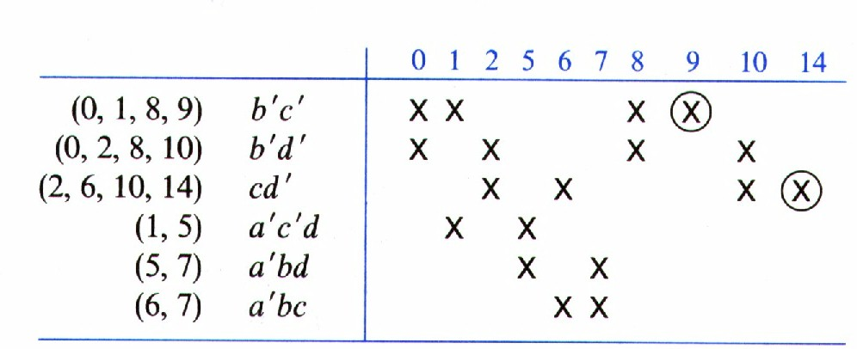
Prime Implicant Chart
Chart layout
Top row lists minterms of the function
All prime implicants are listed on the left side.
Place x into the chart according to the minterms that form the corresponding prime implicant.
Essential prime implicant
If a minterm is covered only by one prime implicant, that prime implicant is called essential prime implicant. (9 & 14).
Essential prime implicant must be included in the minimum sum of the function.

Slide 41
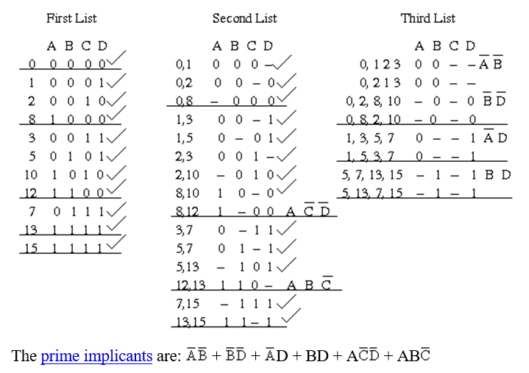

Slide 42
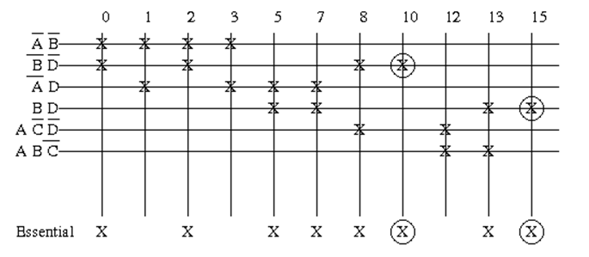


Slide 43
F(A,B,C,D) = Σm(2,6,8,9,10,1,14,15)
Group Name | Min terms | W | X | Y | Z
GA1 | 2 | 0 | 0 | 1 | 0
 | 8 | 1 | 0 | 0 | 0
GA2 | 6 | 0 | 1 | 1 | 0
 | 9 | 1 | 0 | 0 | 1
 | 10 | 1 | 0 | 1 | 0
GA3 | 11 | 1 | 0 | 1 | 1
 | 14 | 1 | 1 | 1 | 0
GA4 | 15 | 1 | 1 | 1 | 1
Group Name | Min terms | W | X | Y | Z
GB1 | 2,6 | 0 | - | 1 | 0
 | 2,10 | - | 0 | 1 | 0
 | 8,9 | 1 | 0 | 0 | -
 | 8,10 | 1 | 0 | - | 0
GB2 | 6,14 | - | 1 | 1 | 0
 | 9,11 | 1 | 0 | - | 1
 | 10,11 | 1 | 0 | 1 | -
 | 10,14 | 1 | - | 1 | 0
GB3 | 11,15 | 1 | - | 1 | 1
 | 14,15 | 1 | 1 | 1 | -

Slide 44
Group Name | Min terms | W | X | Y | Z
GB1 | 2,6,10,14 | - | - | 1 | 0
 | 2,10,6,14 | - | - | 1 | 0
 | 8,9,10,11 | 1 | 0 | - | -
 | 8,10,9,11 | 1 | 0 | - | -
GB2 | 10,11,14,15 | 1 | - | 1 | -
 | 10,14,11,15 | 1 | - | 1 | -
Group Name | Min terms | W | X | Y | Z
GC1 | 2,6,10,14 | - | - | 1 | 0
 | 8,9,10,11 | 1 | 0 | - | -
GC2 | 10,11,14,15 | 1 | - | 1 | -

Slide 45
Min terms / Prime Implicants | 2 | 6 | 8 | 9 | 10 | 11 | 14 | 15
YZ’ | 1 | 1 |  |  | 1 |  | 1
WX’ |  |  | 1 | 1 | 1 | 1
WY |  |  |  |  | 1 | 1 | 1 | 1
f(W,X,Y,Z) = YZ’ + WX’ + WY.

Slide 46
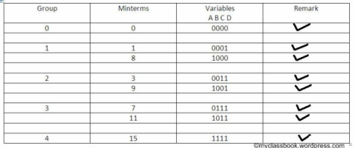
F(A,B,C,D) = Σm(0,1,3,7,8,9,11,15)

Slide 47
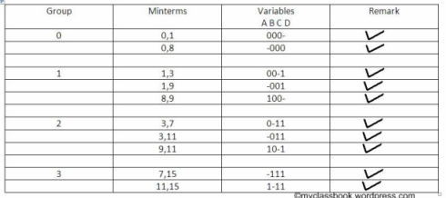

Slide 48
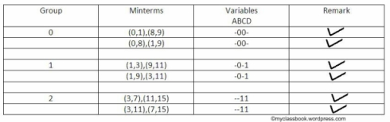
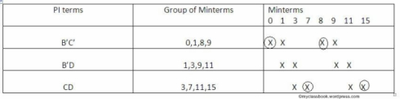
(B’C’+CD).

Slide 49
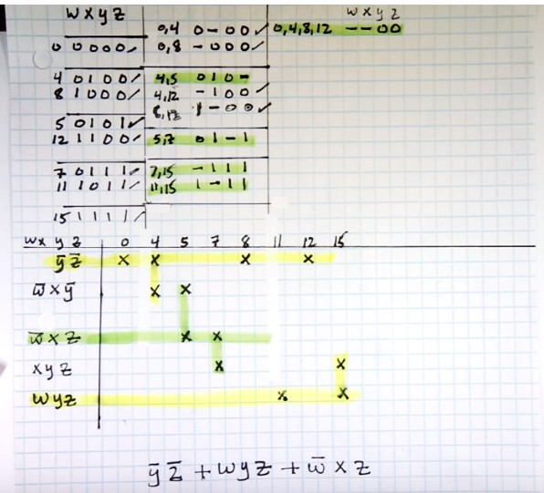
F(w,x,y,z) = Σm(0,4,5,7,8,11,12,15)

Slide 50
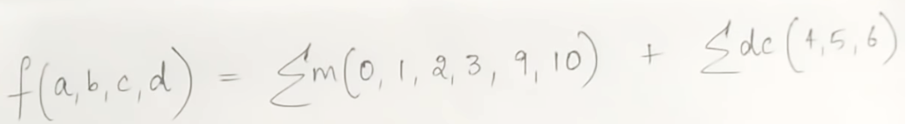
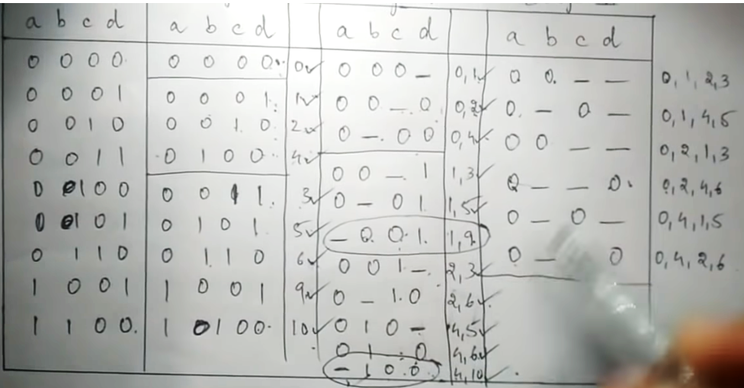
f(a,b,c,d) = Σm(0,1,2,3,9,10) + Σd(4,5,6)

Slide 51
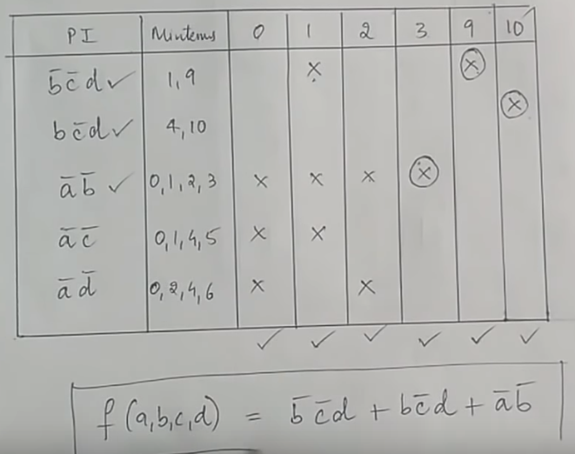

Slide 52
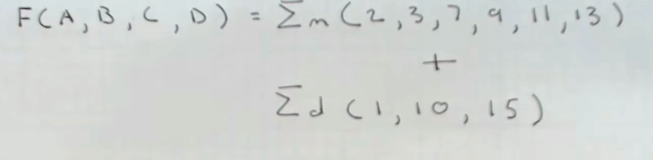
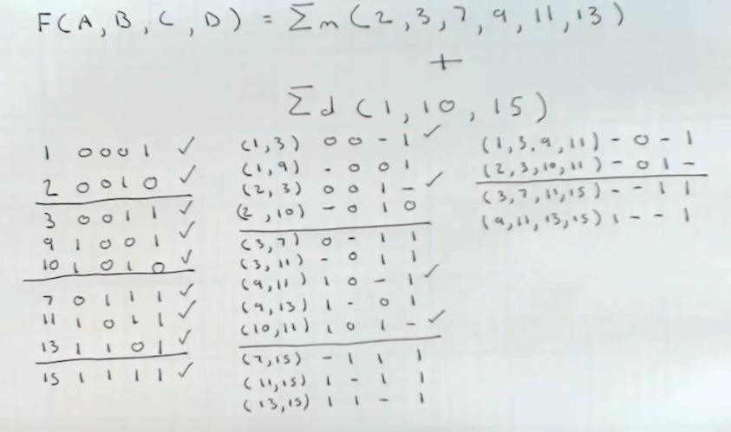

Slide 53
